Slide 1
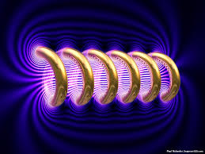
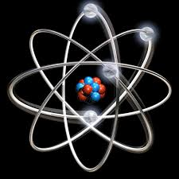

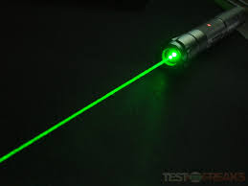
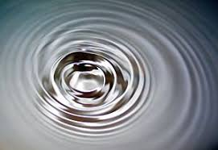
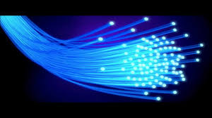
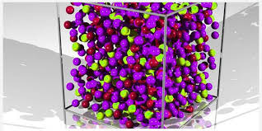
Engineering Physics
PHY-109
Waves-3
ELECTROMAGNETIC THEORY
QUANTUM MECHANICS
LASER
WAVES
Dr. Jeeban Pd Gewali
Department of Physics
Lovely Professional University
Phagwara, Punjab-144411
SOLID STATE PHYSICS
FIBER OPTICS

Slide 2
Syllabus
Interference phenomenon and Concept of resonance
Audible, ultrasonic and infrasonic waves. Production of ultrasonic waves by magnetostriction method.
Ultrasonic transducers and their uses, applications of ultrasonic waves, detection of ultrasonic waves (Kundt's tube method, sensitive flame method and piezoelectric detectors)
Absorption and Dispersion of ultrasonic waves.
Superposition of two waves, sound wave and its velocity, standing waves, Formation of beats, Supersonic and shock waves.

Slide 3
Ultrasonic transducers
A transducer is any device which is used to convert one form of energy to another.
Ultrasonic transducers convert electrical energy to mechanical energy and vice versa.
The ultrasonic transducers can be made to be operative on the principle of piezoelectric effect or magnetostrictive effects.
The magnetostrictive transducers can be used to produce high intensity ultrasonic sound in the 20-40 kHz range for ultrasonic cleaning.

Slide 4
Ultrasonic Transducers Construction
They are constructed by incorporating one or more piezoelectric vibrator which are electrically connected to the pulsing-receiving system.
It includes an ultrasonic transmitting/receiving element typically consisting of piezoelectric element connected to the electrodes.
The piezoelectric elements are typically made of material such as lead zirconate titanate (PZT) with a plurality of elements being arranged to form a transducer assembly. The assembly is then further assembled into a housing possibly including control electronics, in the form of electronic circuit boards, the combination of which forms an ultrasonic probe.
The active element is at the heart of the transducer as it converts the electrical energy to acoustic energy and vice versa.
The active element is basically a piece of polarized material with electrodes attached to two of its opposite faces. When an electric field is applied across the material, the polarized molecules will align themselves with the electric field. Resulting in induced dipoles within the molecular or crystal structure of the material. This alignment of molecules will cause the material to change dimensions. This phenomenon is known as electrostriction.

Slide 5
Detection of ultrasonic waves
Three major methods of detection of ultrasonic waves is
Kundt’s Tube Method
Sensitive Flame Method
Piezoelectric Detector

Slide 6
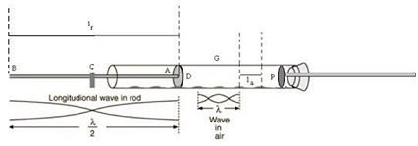
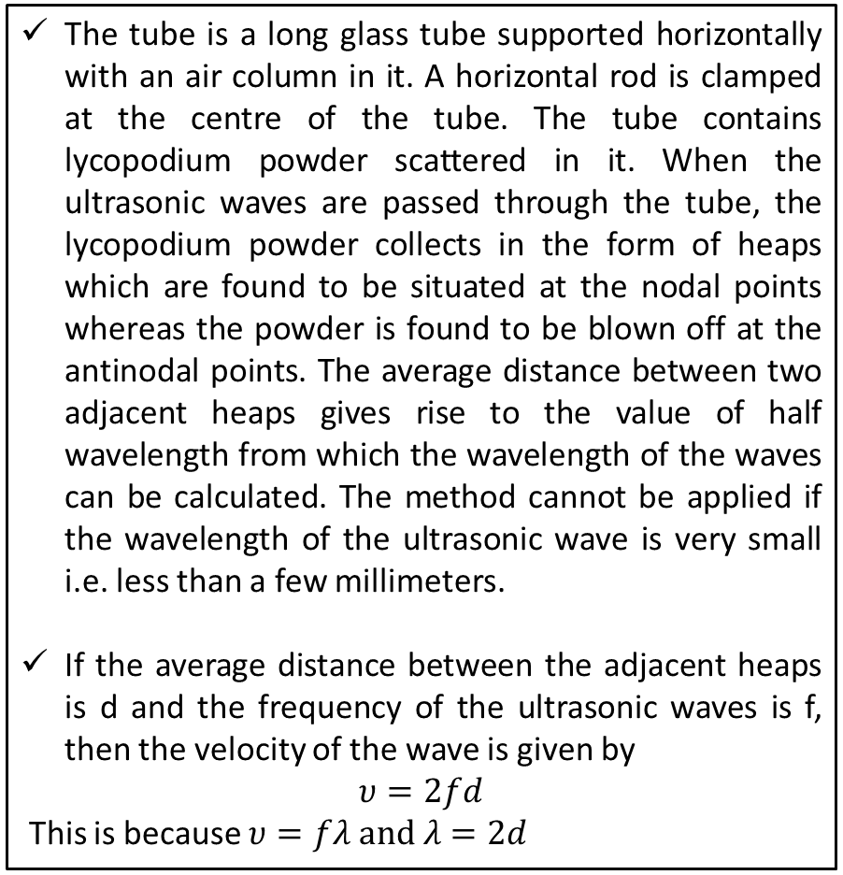
Kundt’s Tube
The tube is a long glass tube supported horizontally with an air column in it. A horizontal rod is clamped at the centre of the tube. The tube contains lycopodium powder scattered in it. When the ultrasonic waves are passed through the tube, the lycopodium powder collects in the form of heaps which are found to be situated at the nodal points whereas the powder is found to be blown off at the antinodal points. The average distance between two adjacent heaps gives rise to the value of half wavelength from which the wavelength of the waves can be calculated. The method cannot be applied if the wavelength of the ultrasonic wave is very small i.e. less than a few millimeters.
If the average distance between the adjacent heaps is d and the frequency of the ultrasonic waves is f, then the velocity of the wave is given by
$$υ=2fd$$
This is because $υ=fλ and λ=2d$
Heaps of Powder

Slide 7

Sensitive Flame Method
Works on the basis of interaction of wave and a sensitive flame, where the change in pressure is noticed.
A narrow sensitive flame is moved along the medium and the change in intensity is noticed.
At the position of antinodes the flame is found to be steady, while the flame is found to flicker at the positions of nodes due to a change taken place in the pressure.
The positions of the nodes and antinodes are found out in the medium and the average distance between the two adjacent nodes gives rise to the value of half wavelength.

Slide 8
Piezoelectric Detector
The piezoelectric method can also be used for the detection of the ultrasonic waves.
If the ultrasonic waves comprising compression and rarefactions are allowed to fall upon a quartz crystal, a certain potential difference is developed across the faces of the crystal and varying electric charges are produced. These small charges after amplification by an electronic circuit are used to detect the ultrasonic waves.

Slide 9
Applications of ultrasonic waves
Medical Applications:
Diagnosis - Scanning of internal organs, vessel’s and tissues of patient’s body based on ultrasonic waves is called ultrasonography. This makes use of high frequency sound waves to produce the images of internal organs and structures for the medical examination and it is possibly the best of all ultrasonic medical applications. The ultrasonic scans are less costly, quicker and easier to use than MRI and CT scans. This technology is used for the scanning of organs like kidneys, liver or gall bladder.
Surgery - Ultrasonic surgical instruments convert an ultrasonic signal into a mechanical vibration by use of a transducer. A waveguide is then used to amplify and propagate the vibration to a desired position. These cut bone and other tissue. They reduce bleeding by coagulating tissue. It gives rise to the concept of knifeless surgery.
Non invasive therapeutic applications – By using ultrasonic energy to heat and destroy diseased tissues, these methods can be used to remove body tissue while treating the cancers and other conditions. Ultrasound imaging technique can locate and target liver, kidney or gallbladder stones. These are smashed into pieces by ultrasound pulses.
Dental Care – High frequency ultrasonic waves can be used as descalers to remove plaque (A film of mucus and bacteria deposited on the teeth that encourages the development of dental caries or cavities).
Hygiene safety – Ultrasonic cleaning uses a special wash solution to reach and effectively remove organic waste from difficult-to-clean areas, such as equipment or devices with joints and crevices.

Slide 10
Applications of ultrasonic waves
Industrial Applications:
Machining – Ultrasonic machining is a vibratory process which is now common use for the mechanical treatment of hard and brittle solids such as glasses, ceramics, precious stones, semiconductors, and hard alloys. A glass rod vibrating with ultrasonic frequency can be used to bore holes in steel and other hard metals.
Welding – Ultrasonic waves generate heat at the contact area as a result of friction arising between the surfaces. As the temperature of surface’s layers exceeds the crystallization point, both the layers melt and make a bond together to form a strong joint. The process induces a negligible stress on the spot of welding.
Cleaning –

Slide 11
Absorption and Dispersion of ultrasonic waves

